Slide 1
CS 498
Virtual Reality
Production & Design Processes

Slide 2
Project Schedule Update
Project Deliverables | Canvas Templates | Discovery: Feb. 25, 2019 @ 11:59 PM Pre-Production: Mar. 11, 2018 @ 11:59 PM Alpha: Apr. 29, 2019 @ 11:59 PM Final Submission: Week of 5/6/2019

Slide 3
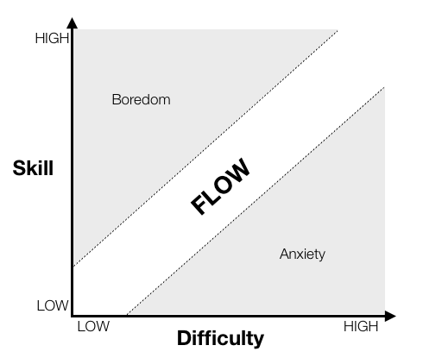
What is Production and why does it matter?
Production drives:
The creation of an atmosphere to support Productivity
Planning
Budgeting
Team Communication
Provides the eyes and ears for studio leadership into the team progress and overall mental state
Risk management
Staffing requirements
Decisions around scope and feature development
Copyright Gamasutra: Cognitive Flow: The Psychology of Great Game Design

Slide 4
Old School production processes
The infamous Task List
Loved by many a programmer
Doesn’t take into account dependencies
Often driven by preference
The Hive mind
Used by small teams usually working in one room
Everyone knows what everyone is doing so planning isn’t as necessary
Doesn’t pass “the bus test”
Doesn’t deal with scope or “creative direction” and can be an issue with dependencies

Slide 5
A Simple Project Plan
Contains:
High and mid-level Design Elements
Vision Canvas
Feature List
Action Loops
Simple Technical Design Doc
Simple Milestone doc (instead of a true schedule)
QA test plan

Slide 6
Simple Feature List
Number | Feature | Top Level Description | Priority | Difficulty | Time To Implement | Risk/Considerations | Comments
F001 | Melee Combat | Primary combat system | High | High | High | Animations may require modifications to the animation system
 |  |  |  |  |  | Camera system needs to pan relative to the attack type
 |  |  |  |  |  | VFX needs to differ for each weapon (may impact schedule)
F002 | Quadripeds | We want to support enemies with 4 legs | High | High | High | The volume of animations | We may be able to use the regular system and fake it
F003 | Clouds | Add moving clouds to the sky dome | Low | Moderate | High | New system | Nice to have if possible
 |  |  |  |  |  | Players may expect weather
F004 | Cover | Ability to hide behind objects | Med | Med | Med | Objects need to be of certain heights, specs need to be created | Would make the combat system more interesting
 |  |  |  |  |  | May add complexity to the combat swings

Slide 7
Technical Design Document: Built from the Feature List
Breaks down the Feature List into technical appropriate segments
Specifics will be programming elements
Systems (combinations of related tasks/features)
One-off features
Clarifies the priorities, risks and dependencies

Slide 8
Ver 1.1 | Modified 9/11/2018
Ref # | System Name | Feature Supported | Feature Specifics | Priority | Difficulty | Risk | Time Estimation | Comments
F001 | Traversal
F001a |  | Camera |  | High | Med | Low
 |  |  | View Frustum |  |  |  |  | To Be determined
 |  |  | Viewing Distance (Scale) |  |  |  |  | Based on Frustrum
F001b |  | Controls |  | Med | Low | Low |  | Timing based on Environmental layout
 |  |  | Walk
 |  |  | Run
 |  |  | Jump
 |  |  | Crouch
F001c |  | Determine Player Location |  | Low | Low | Low
F002 | Melee Combat
F002a |  | Camera |  | High | Med | Med
 |  |  | Over the Shoulder
F002b |  | Controls |  | High | Med | Low
 |  |  | Thrust
 |  |  | Swing
 |  |  | Counter
 |  |  | Block

Slide 9
Milestone Plan
Weekly or Bi-weekly set of tasks to be done by the team
Tracked to:
Show progress
Expose scope issues
Determine risks
Ensure that the correct dependencies are being considered

Slide 10
Project: | Your Project name goes here
Date | Milestone | Task | Assets Needed | % Complete | Comments
1/30/19 | Design
 |  | Create Vision Canvas | None
 |  | Create Tone Target | None
 |  | Create Art Spectrum | None
2/15/19 | Design II
 |  | Create Tech Design Doc | None
 |  | Create Feature List | None
 | Feature I
 |  | Ex: Inital Play Area layout | Example: Initial UI elements
 |  |  | Initial Contact Interface
 |  |  | Initial Movement System, etc
Insert New Dates | Insert new Milestones | Insert New Tasks | Insert New Asset Lists |  | Add new rows to include new milestones, add as many as you need
Simplified Project Plan

Slide 11
Quality Assurance (QA) Test Plan
Details out the elements of each feature to ensure it is working properly
Once you reach Alpha the test plan becomes key to a successful User Experience
Have someone not on the team, run through the test plan
Remember to test integration, where system interact and work together
Most often failures occur here

Slide 12
QA Test Plan |  | Project:_____________________________
Date | Build # | Tester Name
1/14/2019
Test # | Unit/Feature | Item to be Tested | Success/Fail
1 | Main Screen
1a |  | Game Loads properly to Main Screen
1b |  | UI elements change focus correctly
1c |  | Choosing <Start Game> functions correctly by placing the player in the game at the beginning of the first element
1d |  | Choosing <Exit Game> functions correctly closing out the game cleanly and places the player back in the platform interface
1e |  | Choosing <Load Saved Game> functions correctly takes the player to the <Save/Load Game system
1f |  | Choosing <Settings> functions correctly by taking you to the Player Setting System
2 | Performance
2a |  | Game loading time is within spec (loads within XX seconds)
2b |  | General game play shows no hitching or graphic errors
3 | Save Game
3a |  | Game save time is within spec (saves within XX seconds)
3b |  | Saved Game can be reloaded immediately
3c |  | Saved Game Data is correct on reloading

Slide 13
User Interactions
The ideal interaction set
https://www.youtube.com/watch?v=FheQe8rflWQ&t=43s
The goal:
Natural & intuitive, gesture driven interface
Current state of interactions
https://www.youtube.com/watch?v=65u3W7wjXs0
The reality:
Limited input devices, limited range of motion, limited FOV, 2D interfaces in 3D

Slide 14
User Interactions Yasser Malaika (Valve)
Common Interactions are: Object interactions, system commands & navigation
VR related terminology for input devices Maps to
6 DOF (Degrees of Freedom): Within Reach
Pointing Reach & beyond
Hand Control Activation elements (buttons, swiping etc.)
Ambient Invocation: things like voice Indirect & infrequent
Subconscious (your location in space, direction, rotation, etc.) Background
Affordance: aspect of an object that hints at function
Abstract affordances are important in User Comfort
In a person’s mind abstract affordances will lose out to concrete affordances
The more real the look of an affordance the higher the user expectations
If a gesture has meaning it can override the kinematic issues

Slide 15
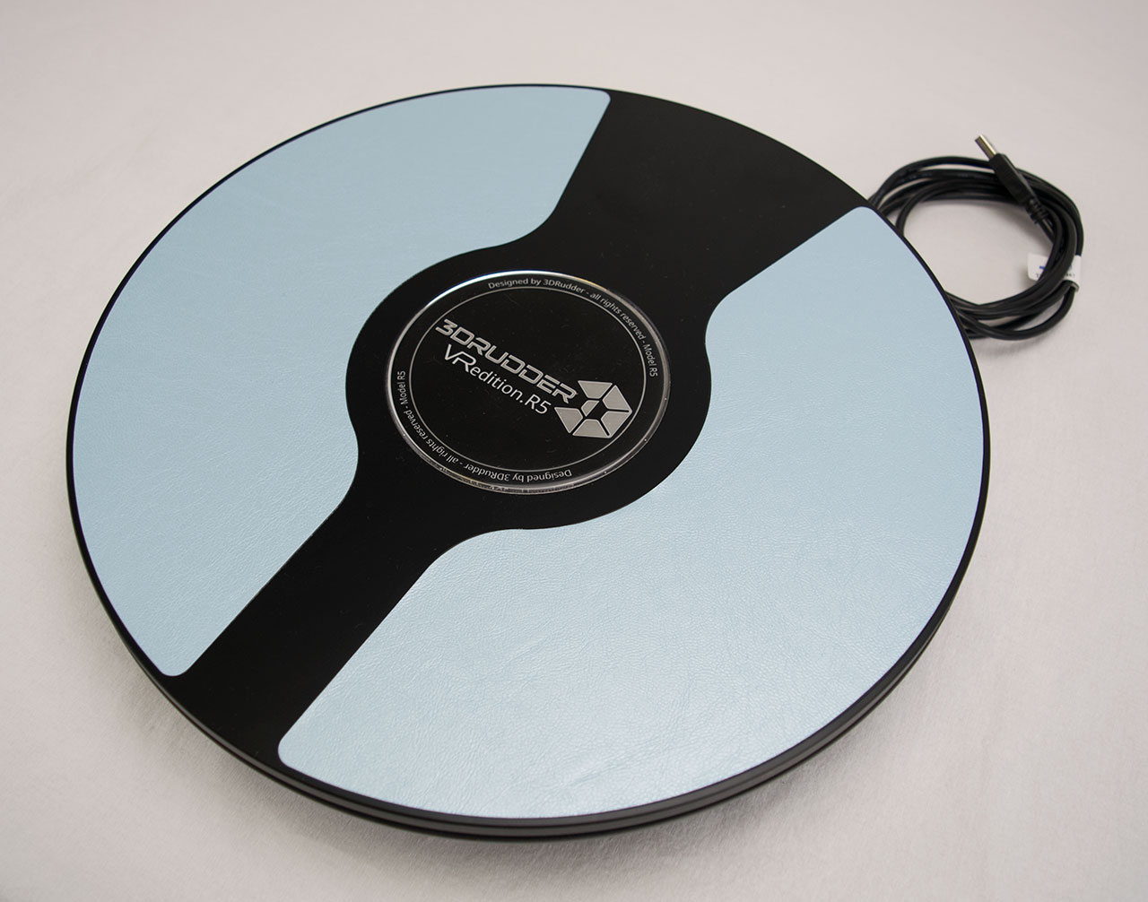
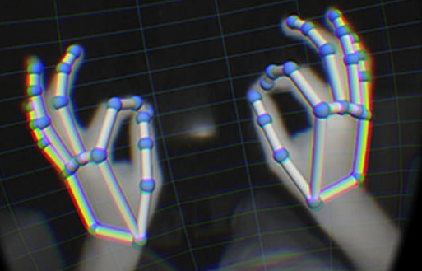
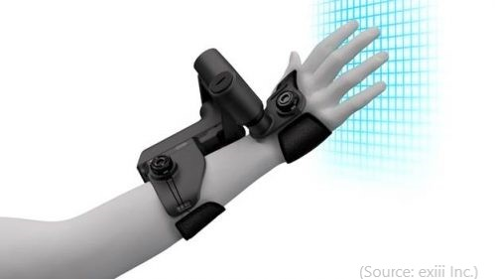
User Intent: Input and Feedback Yasser Malaika (Valve)
Input devices are fairly consistent through the Vive, Rift and PSVR
They offer 6 degrees of freedom and excellent 1 to 1 position tracking
Give developers advantages
Able to target multiple platforms
Set conventions that will develop into standards
Allows the development cultural to borrow from each other quickly
There are a multitude of other devices out there
Hand tracking
Haptic feedback via gloves, and other wearables
Foot devices
Voice command systems
Leap motion
3d rudder.com

Slide 16
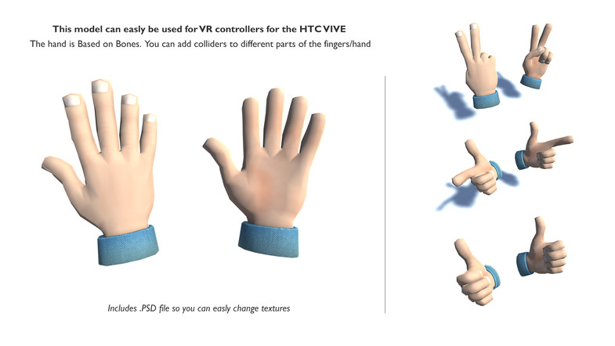

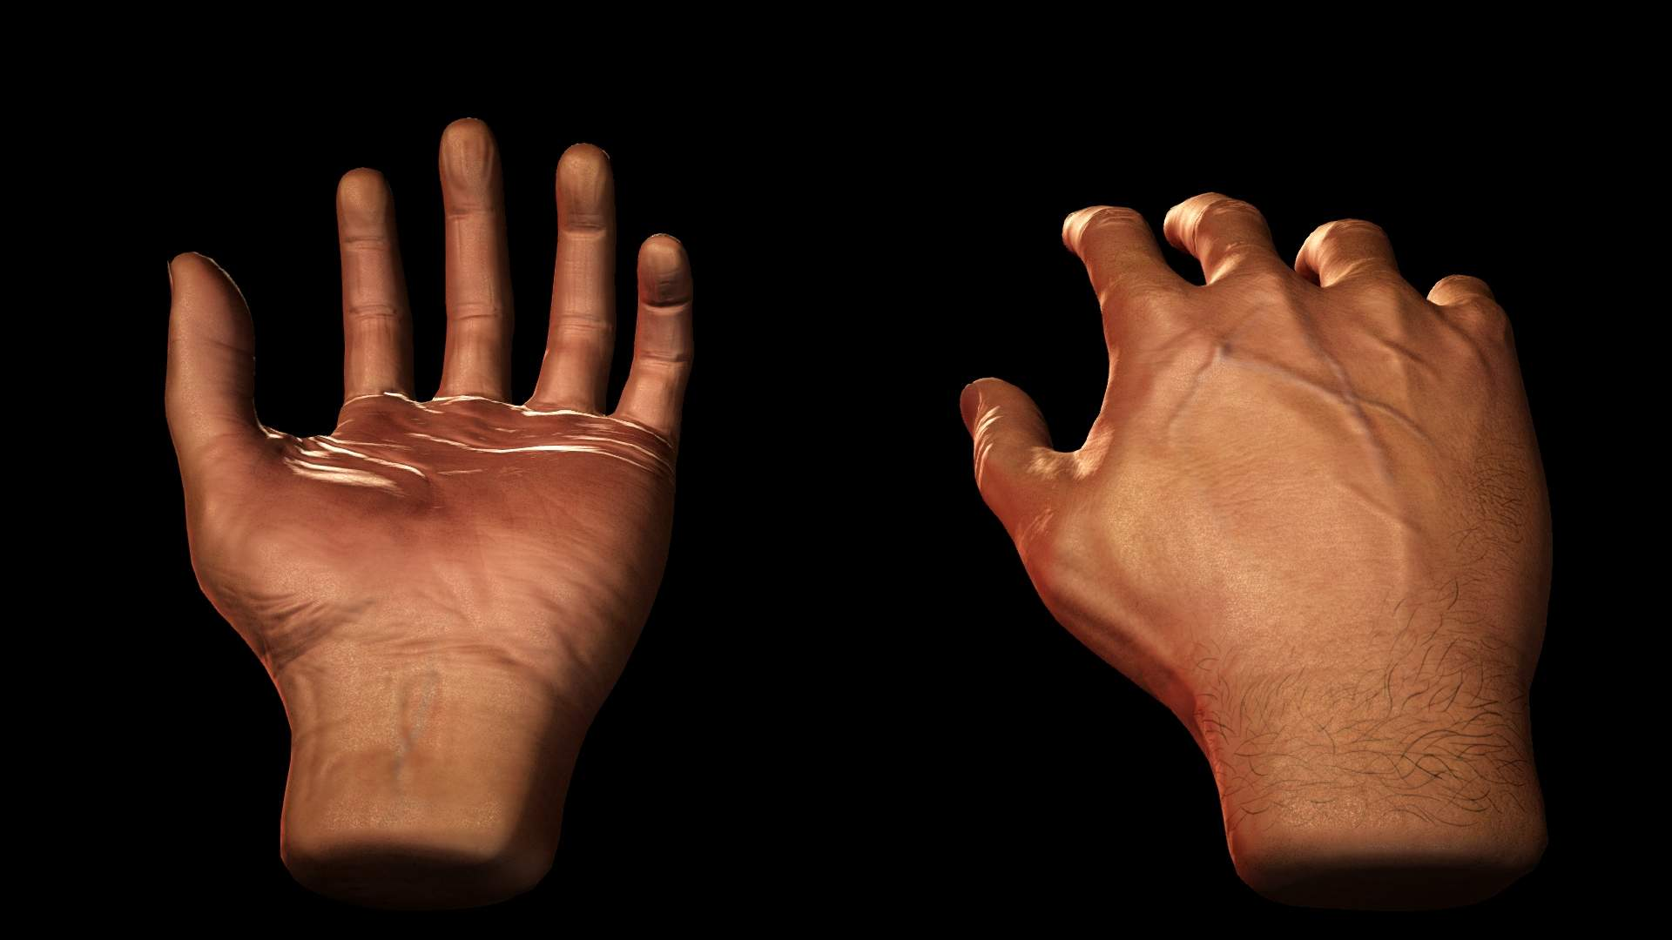
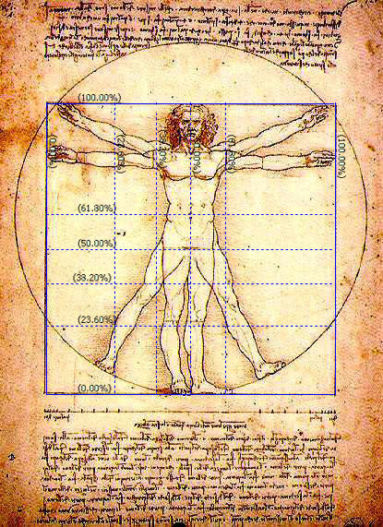
Object Interactions: Selection Yasser Malaika (Valve)
VR input systems map naturally to the human form
Visual (looking around) maps to the head
Movement maps to the legs
Selection/input maps to the arms/hands
Uncanny Valley: When things appear human but not quite, it creates a revulsion in the person.
In VR it actually applies to yourself
Hands are the best example of this
Don ‘t mix them up
Don’t use hands for movement
Head pointing/gaze for selection can be problematic
There are exceptions, teleportation for example
Technology is improving here
Unity Asset store
Renderhub.com

Slide 17
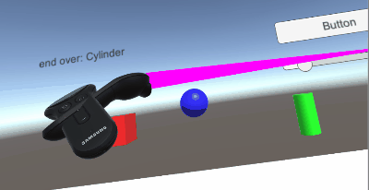
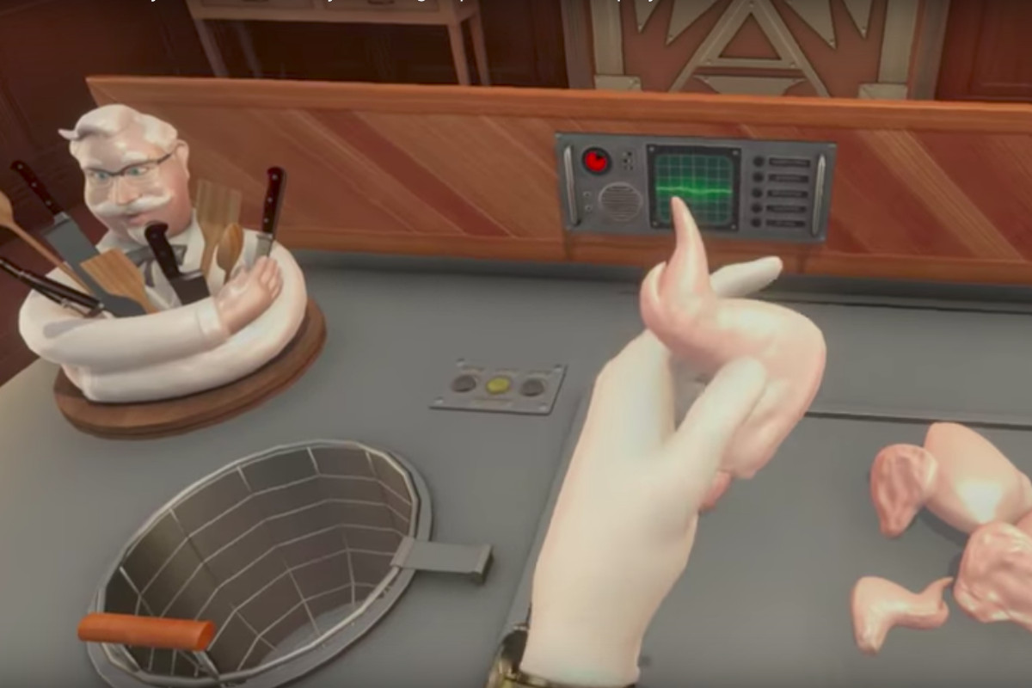
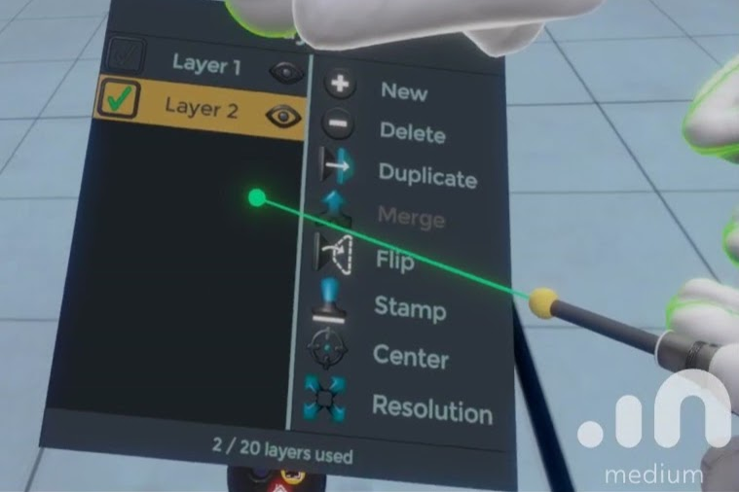
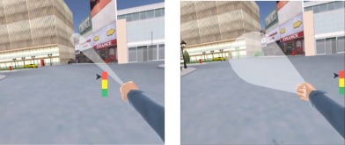
Object Interactions: Selection methodologies
Touching
Within reach (Local zone)
Hands are naturally mapped
You can also use a local pointer
Occlusion
Pretty much your standard 2D menu
Ray Cast (Mid/long range pointing)
Accurate method to choose
Variants include
Cone casting
Snap to (for teleportation)
Oculus developer forums
KFC
© 2017 Elsevier Ltd. All rights reserved.

Slide 18
Object Interactions: Selection methodologies
Arm Extentsion Selection
Go Go Technique
Non-linear mapping between physical and virtual hand position
Local and distant regions (linear < D, non-linear > D)
KFC
Poupyrev, I., Billinghurst, M., Weghorst, S., & Ichikawa, T. (1996). The Go-Go Interaction
Technique: Non-linear Mapping for Direct Manipulation in VR. Proceedings of the
ACM Symposium on User Interface Software and Technology, 79-80.
© 2017 Elsevier Ltd. All rights reserved.

Slide 19
Object Interaction: Considerations Leapmotion.com: design best practices
Interactive elements should be scaled to the expected interaction (e.g. full hand or finger/pointer size).
One finger/pointer targets should be no smaller than 20 mm in real-world size.
This ensures the user can accurately hit the target without accidentally triggering targets next to it.
Keep in mind that human hands naturally move in arcs, rather than straight lines.
Limit the number of gestures that users are required to learn.
All interactions should have a distinct initiation and completion state.
Ensure that users can interact with objects occluded by their hands.

Slide 20
Object Interactions: Selection Feedback
Feedback methods for selection available
Graphical Change
Voice
Color Change
Feedback method for selection made
Audio
Voice
Color Change
Graphic Change
Oculus developer forums

Slide 21
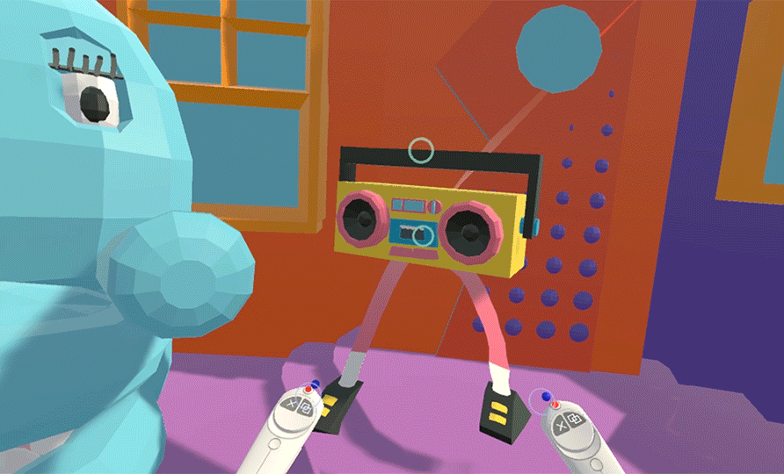
Object Interactions: Manipulation
Attachment, position, rotation, etc.
Examples: https://www.forrestthewoods.com/blog/the_vr_interface_of_dino_frontier/
Vrscout.com

Slide 22
VR Design Specifics
Examples
Hands:
Oculus’ Lone Echo’s https://www.youtube.com/watch?time_continue=42&v=CyP3LZNa_IA
Affordances:
Job Simulator: Gourmet Chef https://www.youtube.com/watch?v=qZX_WVhL3eg
KFC Job Training: 2:00 https://www.youtube.com/watch?v=LritONRSiXc

